Slide 1
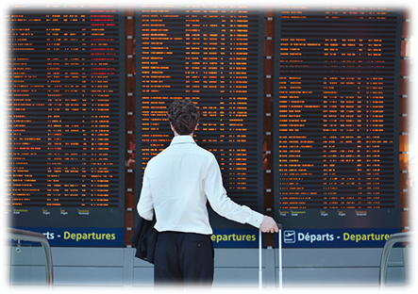
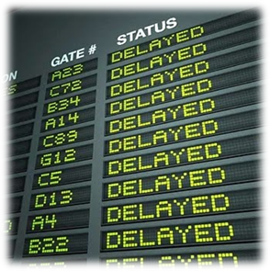

2015 Flight Delays & Cancellations
Amy Tang
Jagruti Patel
Shivangi Patel
Sneha Mani
Notes:
Slides 1-6 - Jagruti - 3 Mins
Slides 7-11 Shiv - 3 Mins
Slides 12- 18 - 5 Mins
Slides 19 - 22 - 5 Mins
Slide 23 - 24 1 Min
Questions 1 Min

Slide 2
Objectives
Background of Data
Data Consolidation, Conversion, and Sorting
Preliminary Analysis
General Data Analysis
Delay Overview
Focused Look at Delays >= 45 Minutes
Conclusion
Notes:
Jagruti

Slide 3
Data Background
Data was obtained from Kaggle, the data source is Bureau of Transportation.
Data set contains information on the number of on-time, delayed, canceled, and diverted flights.
All the information is based on the data provided by the carriers.
Notes:
Jagruti

Slide 4
Data Background (con’t)
Data Set contained 3 files
Airlines - Airline Identifier Codes, Airport Names
14 Total Airlines
Airports - Airport Identifier Codes, Airport Names, City, State, Country, Latitude and Longitude
312 Total Airports
Flights - Domestic Commercial Airline Flights
5,819,079 Rows, 31 Columns
Some of the key columns/attributes include Month, Day, Day of Week, Airline, Flight Number, Origin Airport, Destination Airport,, Departure Delay, Scheduled Time, Elapsed Time, Distance, Scheduled Arrival, Arrival Delay, Diverted, Cancelled, Cancellation Reason, Air System Delay, Security Delay, Airline Delay, Late Aircraft Delay, Weather Delay...and more.
Notes:
Jagruti

Slide 5




Data Consolidation, Conversion, & Sorting
Tools used were: Tableau, R, Excel, and Python
Entire data set was extracted in Tableau to gather high level insights
2015 Data was parsed into monthly chunks using R
Excel was used for additional analysis of monthly data as well as samples from full 2015 dataset
Python was used for the regression analysis
Notes:
Jagruti
Sample dataset looked at 30 min and 45 min above

Slide 6
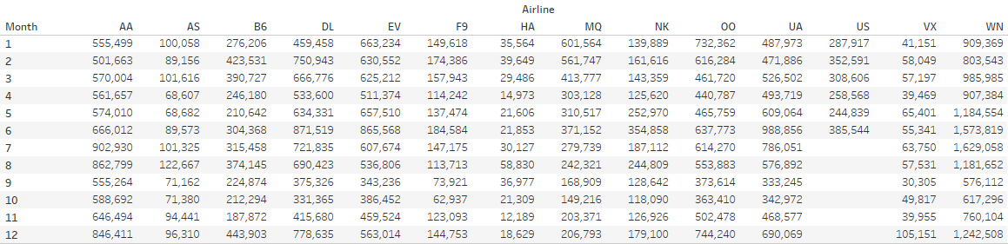
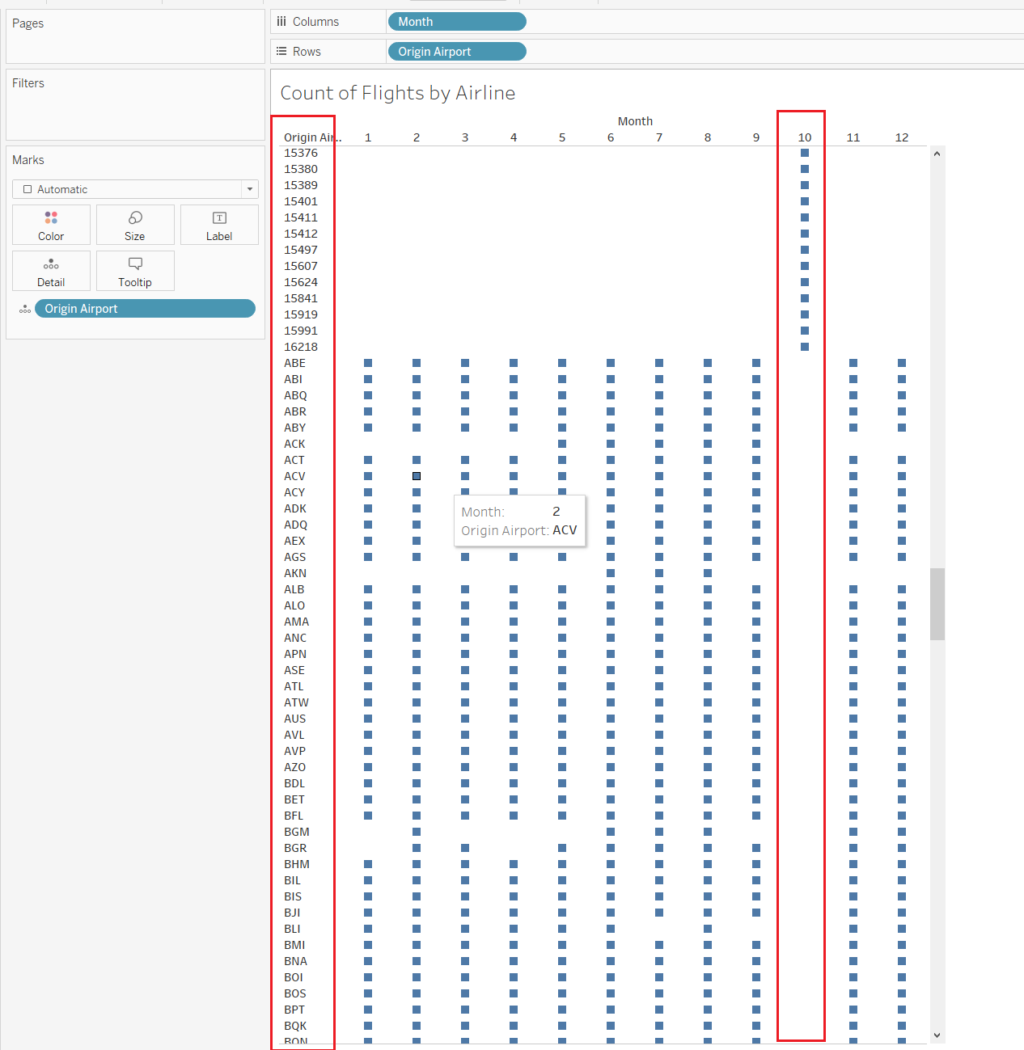
Data Consolidation, Conversion, & Sorting (con’t)
Mergers & Acquisitions
US Airways Inc merged with American Airlines in 2015
US Airways Inc. stops reporting in beginning July in data set
We only consolidated US Airways into American Airlines for the hypothesis test and regression. All general analysis was done with US Airways as a separate entity.
United Airlines merged into American Airlines starting July 2015
There did not seem to be changes in the reporting of UA data as a separate entity
October Data Incomplete/ Inconsistent
Origin Airports and Destination Airports are missing for the month of October
October data was excluded from the analysis

Slide 7
Preliminary Analysis
General analysis on full 2015 data excluding October
No adjustments made for any mergers & acquisitions

Slide 8
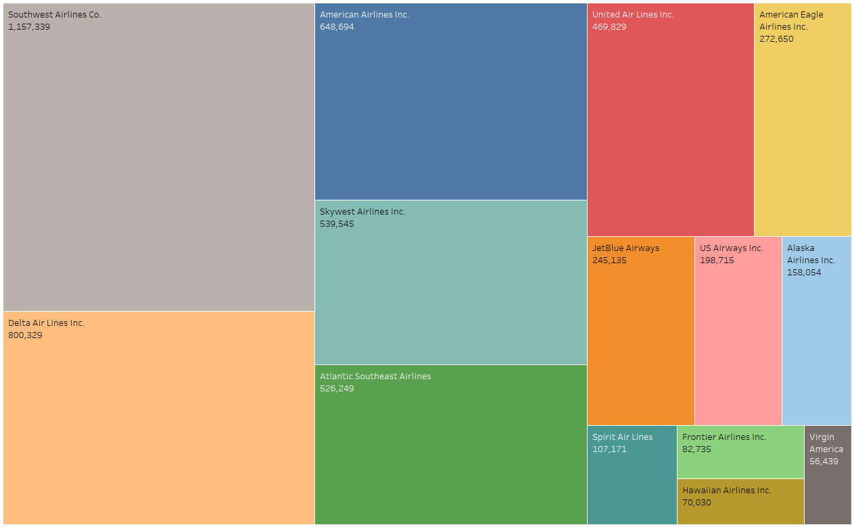
Airline
Volumes
Southwest Airlines Co
1,157,339
American Airline Inc.
648,694
~14 Airlines including US Airways which merged with AA in 2015
Top 5 Airlines make up ~70% of all flights
Skywest Airline Inc.
539,545
Delta AirLines Inc.
800,329
Atlantic Southeast Airlines
526,249
Notes:
~14 Airlines including US Airways which merged with AA in 2015
Top 5 Airlines make up ~70% of all flights
Southwest
Delta
American Airlines
Skywest Airlines
Atlantic Southeast Airlines

Slide 9
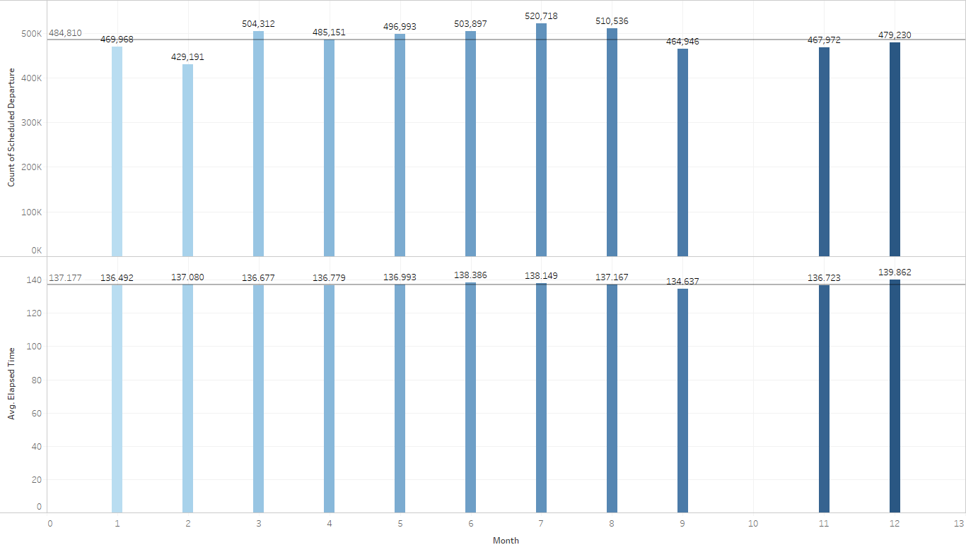
Monthly Travel Trends
~ 5.3MM Flights in 2015 (excl. October)
Avg Travel Flight ~485K/mo
Peak Travel Months >500K/mo
March
June
July
August
Average Travel times ~ 137 min
There doesn’t seem to be much variability in average travel time across the months.
Range across months is ~140 min in Dec - 135 min in Sept.
Notes:
~ 5.3MM Flights in 2015 (excl. October)
Avg Travel Flight ~485K/mo
Peak Travel Months >500K/mo
March
June
July
August
Average Travel times ~ 137 min
There doesn’t seem to be much variability in average travel time across the months.
Range across months is ~140 min in Dec - 135 min in Sept.

Slide 10
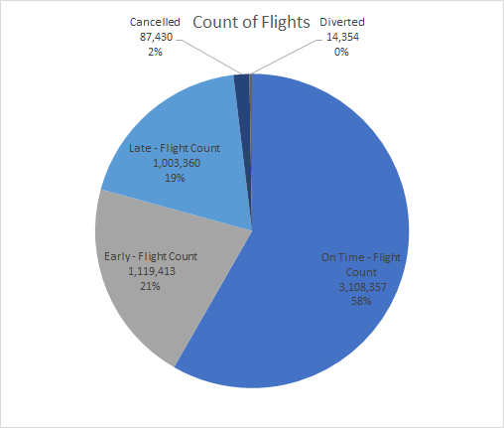
Breakdown by Flight Status
Overall ~ 80% of flights arrive early (>14 min of arrival time) or on time (+/- 14 mins of scheduled arrival time) with a very small % of cancelled & diverted flights
A flight is considered delayed if it arrived at (or departed) the gate 15 minutes or more after the scheduled arrival (departure) time as reflected in the Computerized Reservation System.
Based on this, our analysis will mainly focus on delays.

Slide 11
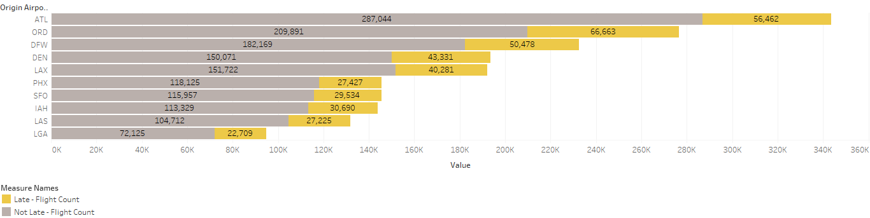
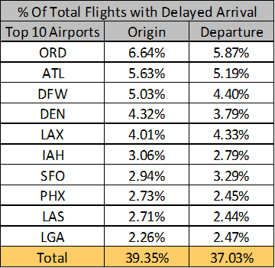
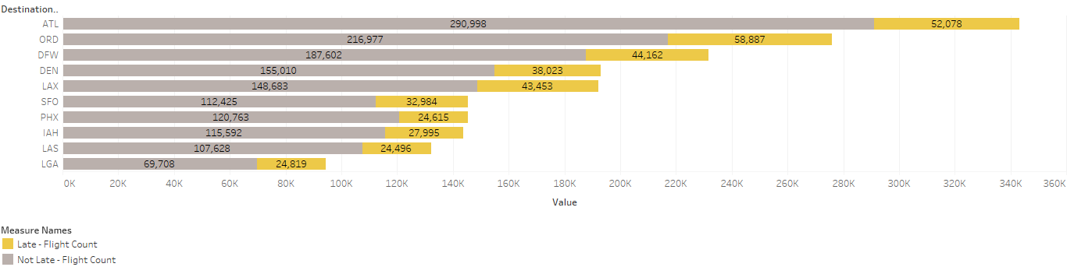
Late Arrivals - Origin/Destination Airport
Relationship between the origin/destination airport & arrival delay?
~312 Airports in Data Set
~40% of total delays are flights into & out of these 10 Airports account for about

Slide 12
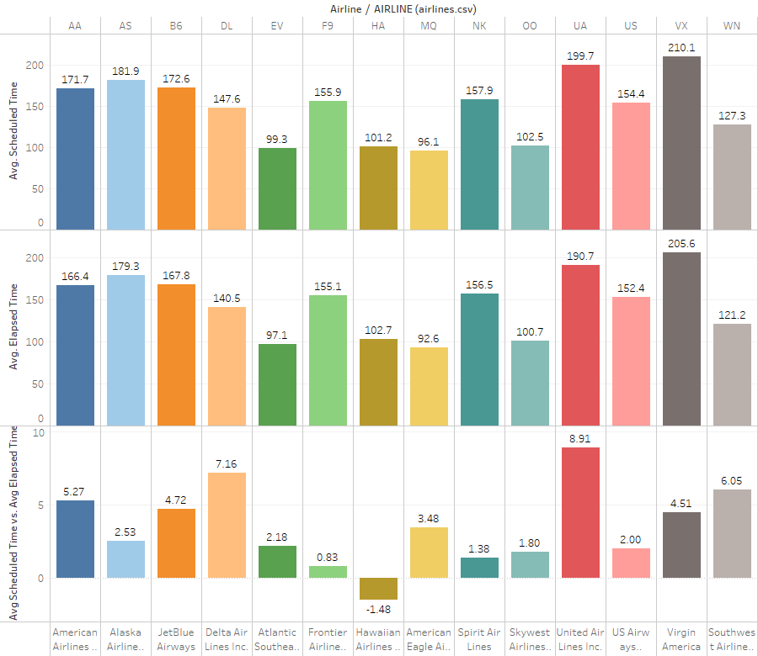
Average Scheduled Time Vs. Average Elapsed Time
United Airlines & Delta have the largest positive differences @ ~9min & ~7 min
Frontier is just barely scheduling enough time at <1 min of buffer
Hawaiian Airlines is not scheduling enough time.
Notes:
We took a look at the average amt of time scheduled for flight by airline as well as the average actual elapsed time by airline.
On the higher end United & Delta had the largest + variance indicating that they are buffering their timelines more than most or they are just better at managing their timeline
Frontier & Hawaiian were the lowest of the bunch - frontier barely scheduling enough time and Hawaiian not scheduling enough time

Slide 13
Types of Delay
Late Aircraft Delay - A previous flight with same aircraft arrived late, causing the present flight to depart late.
Airline Delay - The cause of the cancellation or delay was due to circumstances within the airline's control (e.g. maintenance or crew problems, aircraft cleaning, baggage loading, fueling, etc.).
Air System Delay - Delays and cancellations attributable to the national aviation system that refer to a broad set of conditions, such as non-extreme weather conditions, airport operations, heavy traffic volume, and air traffic control.
Weather Delay - Significant meteorological conditions (actual or forecasted) that, in the judgment of the carrier, delays or prevents the operation of a flight such as tornado, blizzard or hurricane.
Security Delay - Delays or cancellations caused by evacuation of a terminal or concourse, re-boarding of aircraft because of security breach, inoperative screening equipment and/or long lines in excess of 29 minutes at screening areas.
Notes:
So what are the causes of delays? There are 5 categories of delays for flights that arrive at least 15 mins after their scheduled arrival time.
Late Aircraft Delay - when a flight arrives late causing the next flight on that aircraft to be late
Airline Delay - delays due to airline specific processes - maintenance, aircraft cleaning, etc.
Air System Delay - due to national aviation system such as airport ops, heavy traffic, etc.
Weather Delays - which is self explanatory
Security Delays - long lines >29 mins @ screening areas, re-boarding aircraft due to security breach, etc.

Slide 14
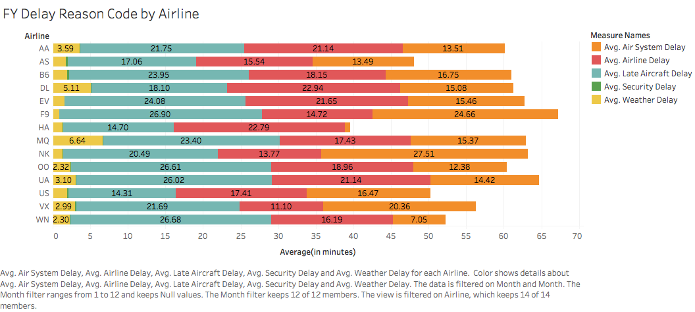
Delay Type Averages by Airline
Notes:
Late Aircraft Delay is the #1 delay reason across all flights and airlines followed by Airline Delays & Air System. To my surprise weather accounted for relatively few delays.
In this graph we looked at the average for the different types of delays by airline.
Not surprisingly Frontier experiences the highest Late Aircraft Delays and Air System Delays and Hawaiian has the 2nd highest Airline delays, exceeded only slightly by Delta

Slide 15
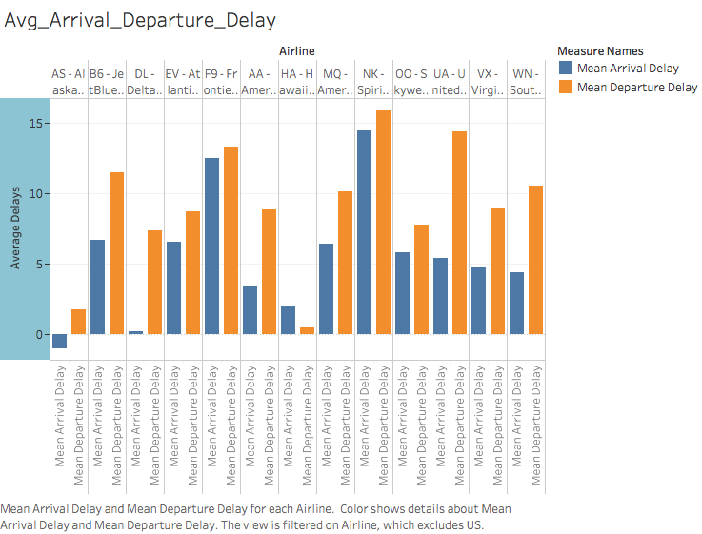
Average Arrival Delay and Average Departure Delay
Notes:
As mentioned in the previous slide primary driver of late arrivals is late aircraft which results in a the next flight being delayed
In this slide we take a look at the average departure delay across airlines relative to the average departure delay
In most instances the departure delay bar is higher which would suggest that most airlines appropriately account and build in time for late aircraft
The one exception being Hawaiian Airline which where the arrival delay is greater than the departure delay

Slide 16
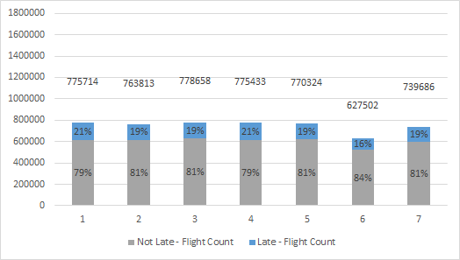
% of Late vs. Not Late Flights by Day
Across the week there are on average ~ 750K flights a day
There are fewer flights on Saturday and Sunday
Saturday has the fewest # of delays as a % of total flights
Mondays and Thursdays seems to be peak flying days with also the highest % of flights that are late
Notes:
We also took a quick look which days of the week had the most delays.
Mondays & Thursdays seem to be peak flying days with the highest % of total flights experiencing delays
While Saturdays saw fewer overall flights and the lowest delays as a % of total for the day

Slide 17
A Focused Look at Delays >=45 Mins
Focused on ‘arrival delay’ >= 45 mins
As delays over 45 minutes can impact your travel plans (cancellations, missed connections etc.)
October was excluded
Mergers & Acquisitions
US Airways was missing data beginning July so it was consolidated into American Airlines
United Airways also merged with American Airlines but as far as we can tell in the data set continued to report separately so no changes were made to the data
Binning used in focused analysis
We had 321 airports in our data set and we wanted to categorize the airports into 4 regions.
Region 1 - Northeast
Region 2 - Midwest
Region 3 - South
Region 4 - West
Days
Friday - Sunday = Weekend = 0
Monday - Thursday = Weekday = 1
Airline Segmentation
Top Airlines (Southwest, Delta, American Airlines, Skywest, Atlantic Southeast) = 0
Regional Airlines (United Airlines, American Eagle, Jet Blue, Alaska, Spirit Airlines, Frontier, Hawaiian, & Virgin) = 1
Notes:
We took a slightly more focused look at flights with delays >=45 Min
Generally with shorter delays you can make up the time but @ 45 mins it becomes quite impactful on your timeline and for folks with connecting flights you risk missing you next flight
We did some additional data conversion for this subset of data
For the 2015 Mergers & Acquisitions we did consolidate US Airways into American Airlines however we left United Airways alone
We Binned the following fields
We binned airports into 4 regions (NE, MW, South & West)
We binned the days into weekend & weekday.
Weekend Fri- Sun
Weekdays Mon-Thurs
We also binned the airlines into the top 5 and all other
The analysis in the following section takes a look at this subset of the data

Slide 18
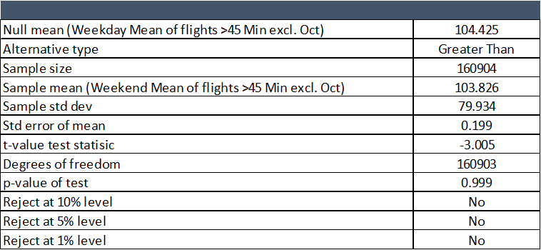
Longer delay on the weekend or weekday?
Does Traveling on the Weekend (Fri- Sun) result in a later arrival than during the week (Mon - Thurs)?
Test Alternative Hypothesis delays longer on weekend and delays longer on weekdays.
Test indicates that delays are not longer on the weekend at any confidence level and alternative hypothesis that weekdays have longer delays are only indicated at the 10% confidence level.
Notes:
As discussed earlier Saturdays experience the fewest delayed flights as a % of total but are the delays themselves longer on the weekends?
We conducted a hypothesis test with the
null hypothesis that weekday flights are do not have longer delays than weekend flights
Alternative hypothesis that weekend flights experience longer delays
The average delay times for the weekdays is ~104.4 mins and the average for the weekday is slightly shorter @ 103.8 mins
The test indicated that we could not reject the null hypothesis at 10%/ 5% / 1%

Slide 19
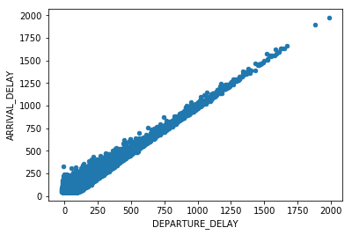
Simple Regression
ARRIVAL_DELAY = B₀+ B₁ * DEPARTURE_DELAY
Notes:
Sneha
Arrival Delay can be expressed as a linear equation of Departure Delay( of the form y=mx+c ) and is basically a coefficient + coefficient (times) Departure Delay.
To depict the linear relationship between Departure Delay and Arrival Delay.
R-squared value - 0.9146, Intercept value - 12.6, B1 coefficient - 0.9146

Slide 20
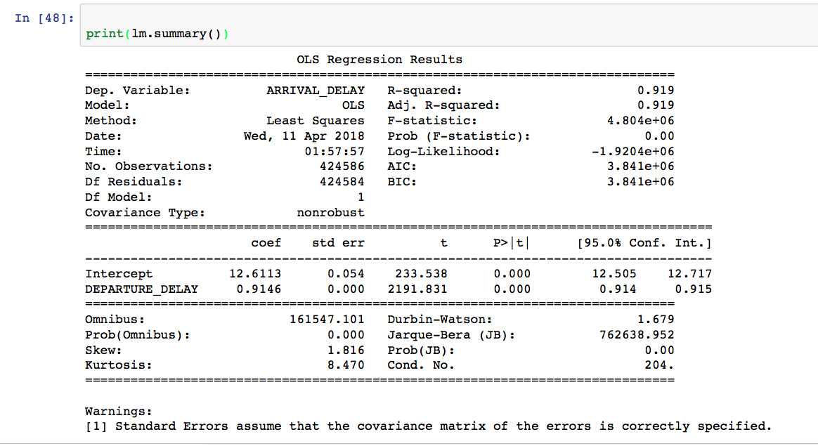
Simple Regression
ARRIVAL_DELAY = 12.6113 + 0.9146 * DEPARTURE_DELAY
Notes:
Sneha
Equation of slope: Y=a+bX ---> Arrival_Delay = 12.6113+0.9146*Departure_Delay, low p value (0) due indicating enough statistical reason to reject null hypothesis. Getting a Correlation of 1.
Arrival Delay increases by 0.9146 minutes for a unit increase in Departure Delay.
Strongly Reject null hypothesis which states that Arrival Delay is not affected by Departure Delay
For every unit increase in Arrival Delay, there must have been a 0.91 minute delay at Departure.
Departure Delay ranging between -22 mins and 1988
minutes. Arrival Delay ranging between 45 and 1971
Average Departure delay: 100.13971727753623
Average Arr Delay: 104.19839325837404

Slide 21
Is there any relationship between the following factors and arrival delays?
Departure Delay
Weekday/Weekend
Top 5 Airline /Non Top 5 Airlines
Elapsed Time
Region of the Originating/Destination Airport
Notes:
Sneha
From our analysis so far, we were able to identify some variables that affect Arrival Delay and are ….
We present our alternate hypothesis that these variables DO affect Arrival delay and a null hypothesis that they do not.

Slide 22
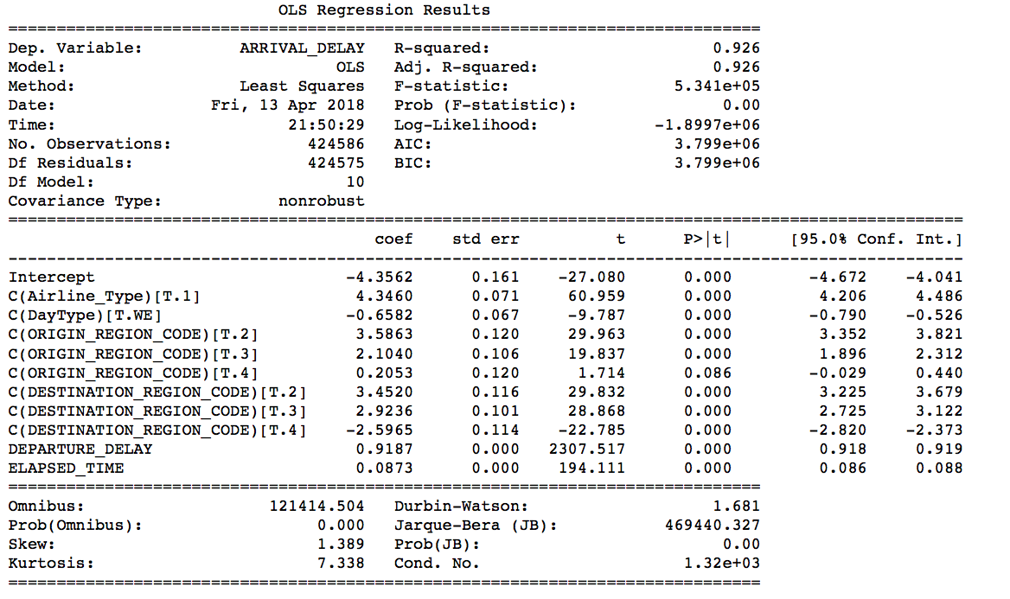
Multiple Linear Regression
Notes:
Sneha
Major Airlines at a base value of 0(WN,AA,OO,Skywest Airlines Inc.,DL,EV,Atlantic Southeast Airlines would be earlier as compared to regional airlines that have a higher positive value ~ 4 minutes(they have an additional 4 minutes adding up to the delay)
Weekday at a base value of 0,when compared with weekend would be earlier by 0.6 minutes.
Region codes - 1 -Northeast,2 - Midwest, 3 - South, 4 - West
If the independent variables were assumed to be 0, then on an average, the flight would arrive early by about 4 minutes for these parameters.

Slide 23
Conclusion
Overall ~ 80% of flights arrive early (>14 min of arrival time) or on time (+/- 14 mins of scheduled arrival time) with a very small % of cancelled & diverted flights.
If you are delayed what’s causing it…
Late aircraft - Delayed arrivals significantly impact overall delays as in many instances a late aircraft usually results in a delayed departure which has a strong correlation with arrival delay.
Airline delays - The cause of the cancellation or delay was due to circumstances within the airline’s control (e.g. maintenance or crew problems, aircraft cleaning, baggage, loading, fueling, etc.)
Air System Delays - Air system delay impacts delay in arrival, especially if you fly in or out of the busy airports.
In a nutshell… many of the delays are not “Acts of God”. Airlines can look at internal processes and partner with airports to improve arrival times.
Notes:
So what’s the take away?
~80 % of your flights are on time/early and a minimal # are cancelled or diverted
There is ~19% of flights that are delayed
If you are delayed the primary causes are late aircraft, airline and air system which in a nutshell are for the most part delays are not caused by “acts of god.”
Airlines can partner with airports to review and improve internal processes to reduce delays
How do you increase your chances of being on time?
Avoid these 10 airports
Stick to flying one of the top 5 airlines and if you can’t try to avoid Frontier & Hawaiian Airlines
Book your flights on the weekend. Ideally on Saturday

Slide 24
Conclusion (con’t)
If you want to increase your chances of being on time
Avoid flying in or out of the following airports. You will most likely be delayed if you can’t avoid it.
ORD-Chicago O'Hare International Airport
ATL-Hartsfield-Jackson Atlanta International Airport
DFW-Dallas/Fort Worth International Airport
DEN-Denver International Airport
LAX-Los Angeles International Airport
IAH-George Bush Intercontinental Airport
SFO-San Francisco International Airport
PHX-Phoenix Sky Harbor International Airport
LAS-McCarran International Airport
LGA-LaGuardia Airport (Marine Air Terminal)
Stick to flying with one of the top 5 airlines. They are more likely to be on time than the smaller airlines.
If you have to go with a smaller airline try to avoid Frontier & Hawaiian. Frontier looks like they are just barely scheduling enough time to arrive on time and Hawaiian isn’t scheduling enough time to make their flights.
Book your flight on for the weekend. Ideally you’d want to fly on a Saturday.
Notes:
Amy

Slide 25

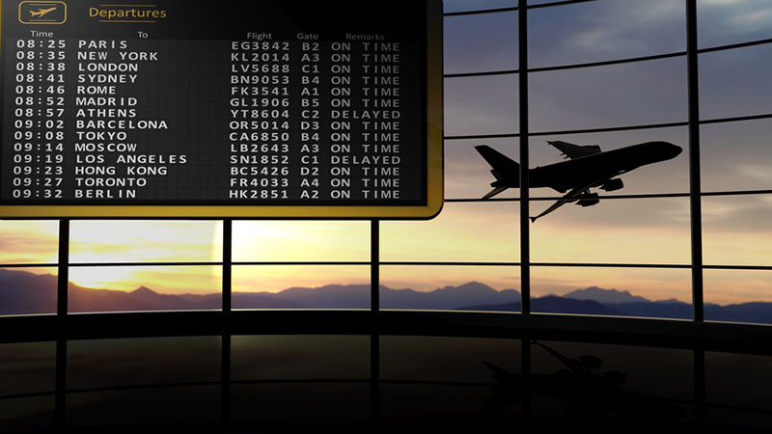
Thank you...

